Slide 1
Important Note Regarding This Microsoft PowerPoint Presentation
* Do not include this slide in your presentation *
This slide deck has been intentionally provided with very limited graphics and formatting to simplify content integration into your own preferred PowerPoint themes and styles.

Slide 2
Security Development Lifecycle (SDL) Field Content
Source Code Annotation Language
(Level 200)

Slide 3
Agenda
Overview of the Microsoft SDL
Overview of Microsoft Source Code Annotation Language (SAL)
Annotation classes:
Buffer
Advanced
Microsoft SDL annotation recommendations

Slide 4

Microsoft Security Development Lifecycle (SDL)
Training
Requirem-ents
Design
Implemen-tation
Verification
Release
Response
Delivering secure software requires:
Executive commitment → SDL a mandatory policy at Microsoft since 2004
Education
Technology and Process
Accountability
Ongoing Process Improvements → 6 month cycle

Slide 5
Microsoft Source Code Annotation Language Overview
Source Code Annotation Language (SAL): Set of annotations to describe how a function uses its arguments, the assumptions made and the execution guarantees that the function provides
Helps describe C/C++ function arguments and return values
Two Source Code Annotation Language implementations:
__declspec syntax (Visual Studio 2005 and 2008)
Attribute syntax (Visual Studio 2008)
Two classes of annotations: Buffer and Advanced
More information at
http://msdn.microsoft.com/en-us/library/ms235402(VS.80).aspx

Slide 6
Key Security Benefits of Source Code Annotation Language
Security Benefit: Helps static analysis tools find more vulnerabilities and improve accuracy
Less false positives and false negatives
Benefits in addition to security
Discovery of vulnerabilities earlier in software development process
Less cost incurred addressing vulnerabilities ealier in the SDLC vs. later
Annotations are not a “silver bullet”

Slide 7
Buffer Annotations Overview
Purpose: To describe pertinent information about a single buffer argument or return value
Used to detect buffer overruns
Buffer Annotations
Optional
Indirection
Direction
Size
Size Units
Initialization
Null-Termination

Slide 8
Buffer Annotations: Optional
_opt | The buffer argument can be NULL.
Describes if the buffer argument is NULL or otherwise
Example:
void OptionalSample
(
__opt TCHAR * buf
)

Slide 9
Buffer Annotations: Indirection
_deref | *p is the buffer pointer, and must not be NULL.
_deref_opt | *p is the buffer pointer, and may be NULL.
Describes level of indirection from the buffer argument or return value
Example:
void IndirectionSample
(
size_t cb
__deref T **ppv
)

Slide 10
Buffer Annotations: Direction
_in | The function will only read from the buffer.
_out | The function will only write to the buffer.
_inout | The function will read and/or write to the buffer.
Describes the direction that a function uses the buffer argument
Example:
void DirectionSample
(
__in LPCSTR pszString
)

Slide 11
Buffer Annotations: Size
(size) | Specifies the total size of the buffer. Used only with _bcount and _ecount.
(size,length) | Specifies the total size and initialized length of the buffer. Use with _bcount_part and _ecound_part.
Describes explicit counts for the size and length of the buffer argument

Slide 12
Buffer Annotations: Size Units
_ecount | The buffer size is an explicit element count.
_bcount | The buffer size is an explicit byte count.
Describes the total size of the buffer argument
Must be used with _in, _out, or _inout
Example:
void SizeUnitsSample
(
__out_ecount(cchBuf) TCHAR * buf,
int cchBuf
)

Slide 13
Buffer Annotations: Initialization
_full | The function initializes the entire buffer.
_part | The function initializes part of the buffer, and indicates how much. Use only with output buffers.
Describes how much of the buffer will be initialized by the function
Example:
void InitializationSample
(
__out_ecount_part(count, *countOut) TCHAR * buf,
int count,
__out int * countOut
)

Slide 14
Buffer Annotations: Null-Termination
_z | An \0 indicates the end of the buffer.
_nz | The buffer may not be null-terminated and a \0 does not indicate the end of the buffer.
Indicates whether the presence of a \0 marks the end of valid elements in the buffer
Example:
void NullTerminationSample
(
__in_z TCHAR * buf
)

Slide 15
Advanced Annotations Overview
Purpose: To describe behavior not expressible with buffer annotations, and provide additional argument information
Indicated as separate annotations and not combined with Buffer annotations
bool FreeStrings
(
__in __nullterminated LPTCH strblock
)

Slide 16
Advanced Annotations
__success(expr) f | Expr indicates whether function f succeeded or not. If expr is true at exit, all annotations must hold.
__nullterminated p | Pointer p is a buffer that may be read or written up to first null character or pointer.
__nullnullterminated p | Pointer p is a buffer that may be read or written up to and including the first sequence of two null characters or pointers
__reserved v | Value v must be 0 or NULL. (Reserved for future use)
__checkReturn v | Return value v must not be ignored by callers of this function.
__typefix(ctype) v | Value v should be treated as an instance of ctype, rather than its declared type.
__override f | Specifies C#-style ‘override’ behavior for overriding virtual methods.
__callback f | Function c can be used as a function pointer.
__format_string p | Pointer p is a string that contains % markers in the style of printf.
__blocksOn(resource) f | Function f blocks on the resource called resource.
__fallthrough | Annoates switch statement labels where fall-through is desired, to distinguish from forgotten break statements.

Slide 17
Using Source Code Annotation Language In Your Applications
Include SAL header (#include “sal.h”)
Code must be compiled with Visual C++ 2005 or Visual C++ 2008 that support /analyze compile-time flag
Alternatively, can be used with Microsoft PREFast analysis tool
http://www.microsoft.com/whdc/DevTools/tools/PREfast.mspx

Slide 18
Source Code Annotation Language Demonstration

Slide 19
Microsoft SDL Annotation Recommendations
Recommended by Microsoft SDL, not required
Start annotating new code
Existing code should be annotated over time
Annotate prototypes of functions that write to and read from buffers
Use already annotated headers where possible (Visual Studio 2005, Visual Studio 2008 and Windows Driver Kit)

Slide 20
Conclusion
Overview of Microsoft SDL
Overview of Source Code Annotation Language (SAL)
Annotation types
Demonstration of Source Code Annotation Language
Microsoft SDL annotation recommendations

Slide 21
Appendix

Slide 22





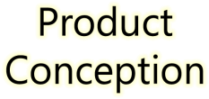
































Microsoft Security Development Lifecycle (SDL)
SDL Book:
http://www.microsoft.com/mspress/books/8753.aspx
Official SDL Web Site: http://www.microsoft.com/sdl

Slide 23


Microsoft Writing Secure Code Book Series
Writing Secure Code,
2nd Edition:
http://www.microsoft.com/mspress/books/5957.aspx
Writing Secure Code for Windows Vista:
http://www.microsoft.com/mspress/books/10723.aspx

Slide 24
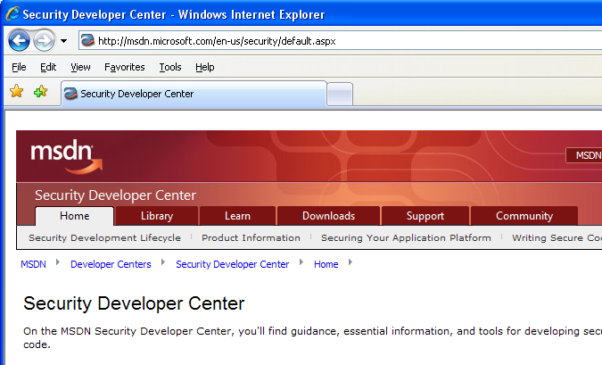

Microsoft Developer Network (MSDN) Security Developer Center
Official Web site: http://msdn.microsoft.com/security

Slide 25
Secure Development Blogs
The Microsoft Security Development Lifecycle (SDL) Blog: http://blogs.msdn.com/sdl
Michael Howard’s Blog: http://blogs.msdn.com/michael_howard

Slide 26

Microsoft Hunting Security Bugs
Hunting Security Bugs:
http://www.microsoft.com/mspress/books/8485.aspx

Slide 27
Additional SDL Training Content
Secure Design Principles
Secure Implementation Principles
Secure Verification Principles
SQL Injection Vulnerabilities
Cross-Site Scripting Vulnerabilities
Buffer Overflow Vulnerabilities

Slide 28
Source Code Annotation Language Resources
Header Annotations (Windows): http://msdn.microsoft.com/en-us/library/aa383701.aspx
SAL Annotations: http://msdn.microsoft.com/en-us/library/ms235402(VS.80).aspx
Using Annotations to Reduce C/C++ Code Defects: http://msdn.microsoft.com/en-us/library/ms182032.aspx

